Slide 1
6.852: Distributed Algorithms Fall, 2015
Lecture 12

Slide 2
Last Time
Asynchronous spanning tree algorithms:
Asynch Spanning Tree (not necessarily breadth-first)
Asynchronous BFS
Asynchronous Shortest Paths
Important observation: In a distributed algorithm, fast execution of portions of the algorithm don’t necessarily result in fastest execution overall.
Different from sequential algorithms.
Also GHS Minimum Spanning Tree algorithm.
Questions?

Slide 3
Today’s plan
Simulating synchronous algorithms in asynchronous networks.
Synchronizers
Lower bound for global synchronization
Reading: Chapter 16
Next:
Logical time, state machine emulation, vector timestamps
Readings:
Chapter 18
[Lamport] Time, Clocks, and the Ordering of Events in a Distributed System
[Mattern] Vector timestamps

Slide 4
Simulating Synchronous Algorithms in Asynchronous Networks (Synchronizers)
U₂
U₁
U_{n}
Synchronizer

Slide 5
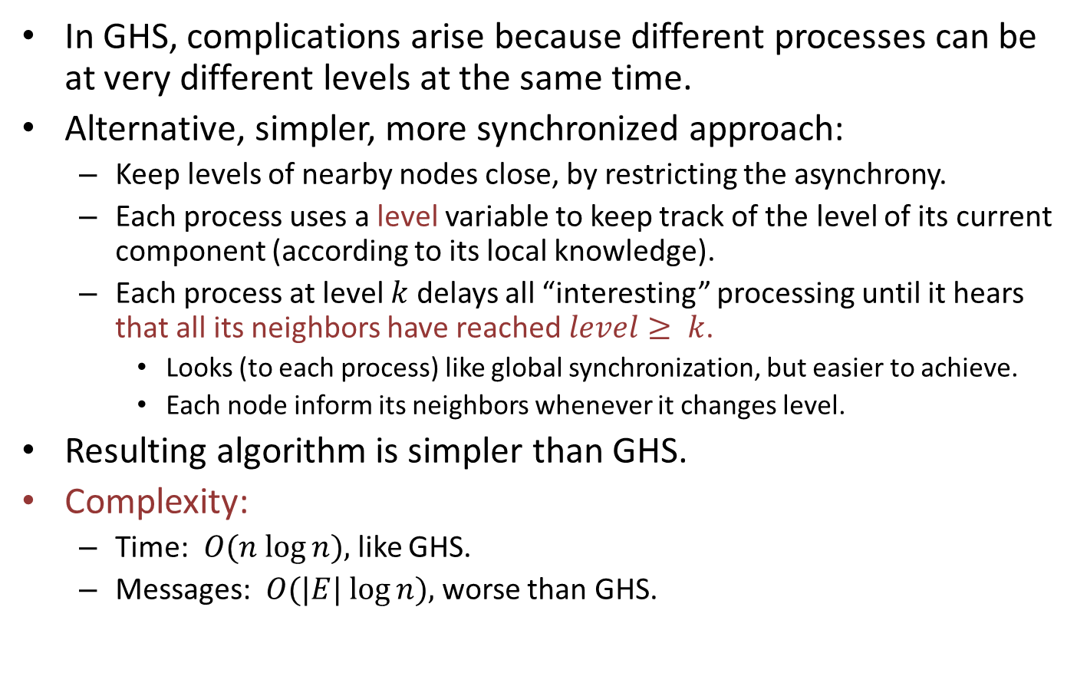
Minimum spanning tree, revisited
In GHS, complications arise because different processes can be at very different levels at the same time.
Alternative, simpler, more synchronized approach:
Keep levels of nearby nodes close, by restricting the asynchrony.
Each process uses a level variable to keep track of the level of its current component (according to its local knowledge).
Each process at level $k$ delays all “interesting” processing until it hears that all its neighbors have reached $level≥ k$.
Looks (to each process) like global synchronization, but easier to achieve.
Each node inform its neighbors whenever it changes level.
Resulting algorithm is simpler than GHS.
Complexity:
Time: $O(n log⁡n),$like GHS.
Messages: $O(|E| log⁡n),$worse than GHS.
Notes:
Looks locally like global synchronization.
But based on synchronizing levels, not individual steps.
This algorithm closely emulates the synchronous algorithm.
The extra communication cost is because the nodes are sending messages on all edges to synchronize with neighbors.

Slide 6
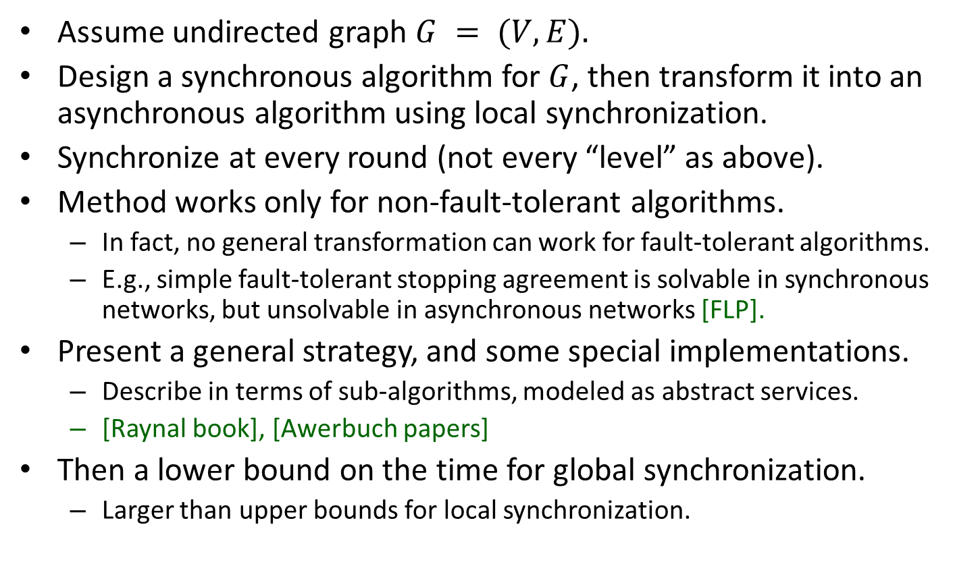
A strategy for designing asynchronous distributed algorithms
Assume undirected graph $G = (V,E).$
Design a synchronous algorithm for $G$, then transform it into an asynchronous algorithm using local synchronization.
Synchronize at every round (not every “level” as above).
Method works only for non-fault-tolerant algorithms.
In fact, no general transformation can work for fault-tolerant algorithms.
E.g., simple fault-tolerant stopping agreement is solvable in synchronous networks, but unsolvable in asynchronous networks [FLP].
Present a general strategy, and some special implementations.
Describe in terms of sub-algorithms, modeled as abstract services.
[Raynal book], [Awerbuch papers]
Then a lower bound on the time for global synchronization.
Larger than upper bounds for local synchronization.
Notes:
Michel Raynal wrote an entire book just on synchronizers.

Slide 7
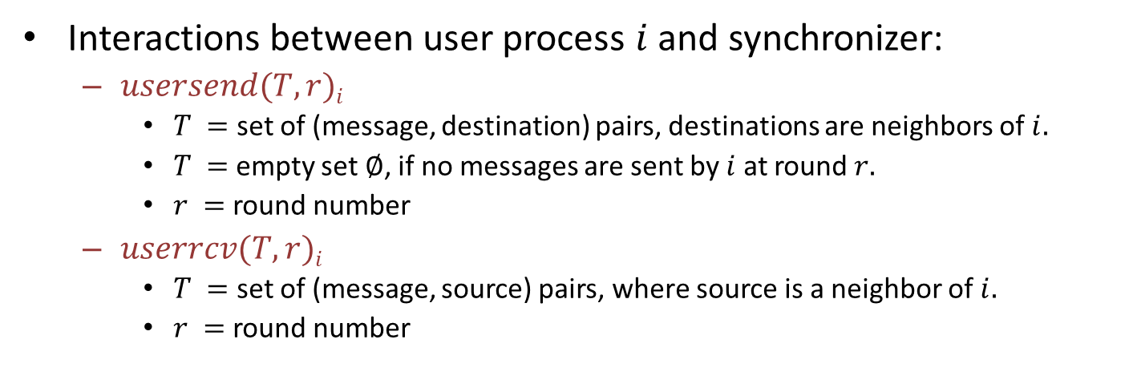
Synchronous model, reformulated in terms of I/O automata
Global synchronizer automaton
User process automata:
Processes of an algorithm that uses the synchronizer.
May have other inputs/outputs, for interacting with other programs.
U₂
U₁
U_{n}
GlobSynch
Interactions between user process $i$ and synchronizer:
$usersend(T,r)i$
$T =$ set of (message, destination) pairs, destinations are neighbors of $i.$
$T =$empty set$∅$, if no messages are sent by $i$ at round $r.$
$r =$round number
$userrcv(T,r)i$
$T =$ set of (message, source) pairs, where source is a neighbor of $i.$
$r =$round number
Notes:
Think of these users as the processes of a synchronous algorithm.
We are describing a global service GlobSynch that manages global synchronization.

Slide 8

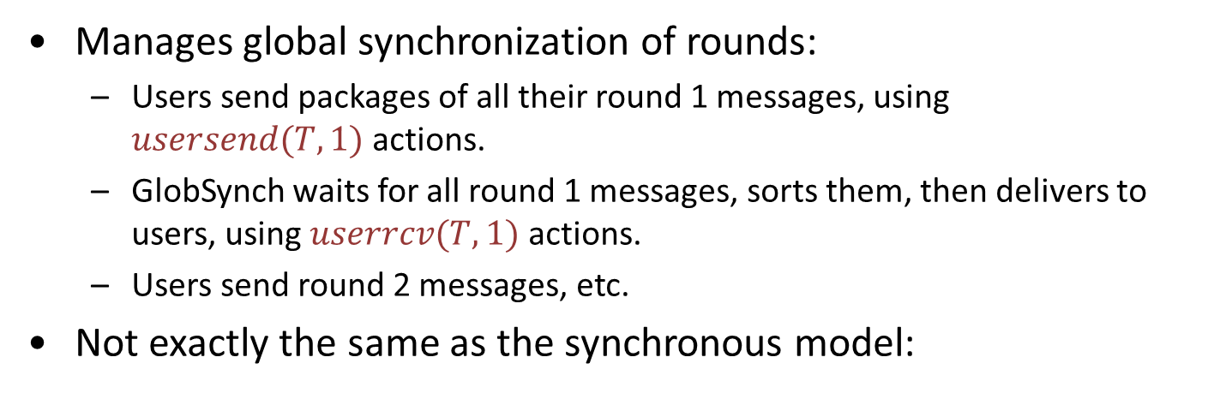
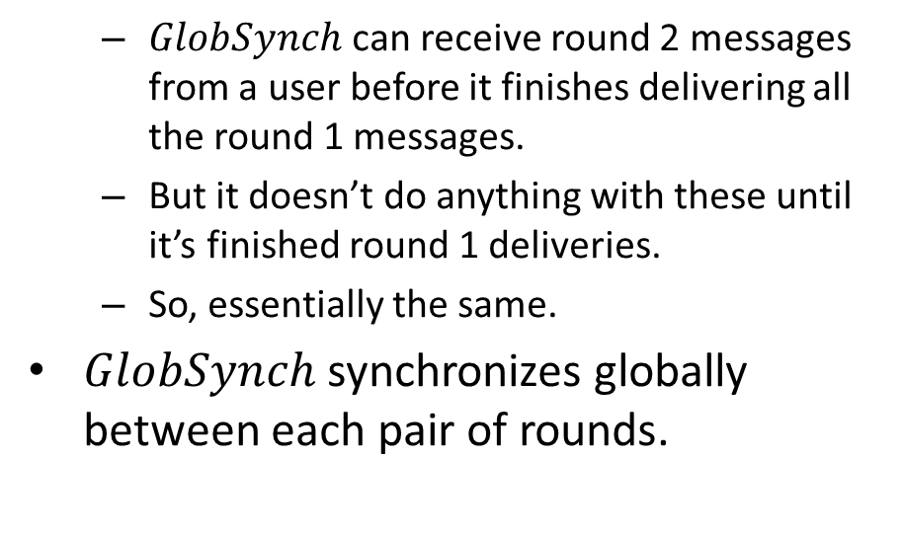
Behavior of $GlobSynch$
Manages global synchronization of rounds:
Users send packages of all their round 1 messages, using $usersend(T,1)$actions.
GlobSynch waits for all round 1 messages, sorts them, then delivers to users, using $userrcv(T,1)$ actions.
Users send round 2 messages, etc.
Not exactly the same as the synchronous model:
$GlobSynch$ can receive round 2 messages from a user before it finishes delivering all the round 1 messages.
But it doesn’t do anything with these until it’s finished round 1 deliveries.
So, essentially the same.
$GlobSynch$ synchronizes globally between each pair of rounds.
U₂
U₁
U_{n}
GlobSynch
Notes:
Global service specification.

Slide 9

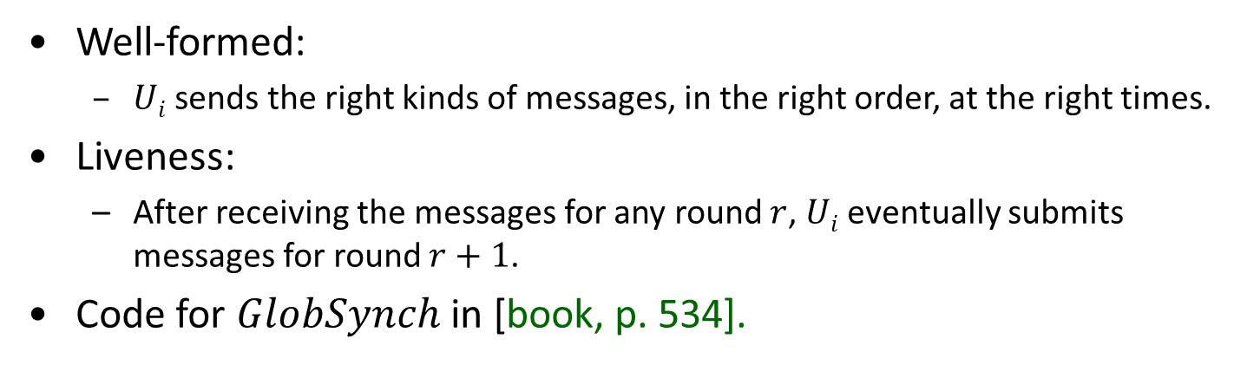
Requirements on each $Ui$
Well-formed:
$Ui$sends the right kinds of messages, in the right order, at the right times.
Liveness:
After receiving the messages for any round $r$, $Ui$eventually submits messages for round $r+1$.
Code for $GlobSynch$ in [book, p. 534].
State consists of:
A tray of messages for each (destination, round).
Some Boolean flags to keep track of which sends and rcvs have happened.
Transitions obvious.
Liveness expressed by tasks, one for each (destination, round).
U₂
U₁
U_{n}
GlobSynch
Notes:
This “state” is for an abstract specification automaton.

Slide 10
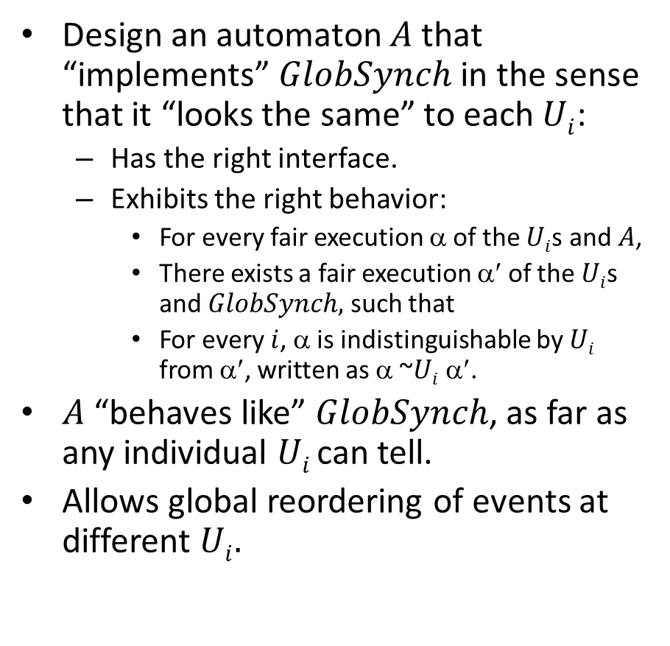
The Synchronizer Problem
Design an automaton $A$ that “implements” $GlobSynch$ in the sense that it “looks the same” to each $Ui$:
Has the right interface.
Exhibits the right behavior:
For every fair execution α of the $Ui$s and $A$,
There exists a fair execution α′ of the $Ui$s and $GlobSynch,$ such that
For every $i$, α is indistinguishable by $Ui$ from α′, written as α ~$Ui$ α′.
$A$ “behaves like” $GlobSynch$, as far as any individual $Ui$can tell.
Allows global reordering of events at different $Ui.$
U₂
U₁
U_{n}
GlobSynch
U₂
U₁
U_{n}
A
Notes:
This may not look completely intuitive at first. We are allowing reordering of events at different locations.

Slide 11
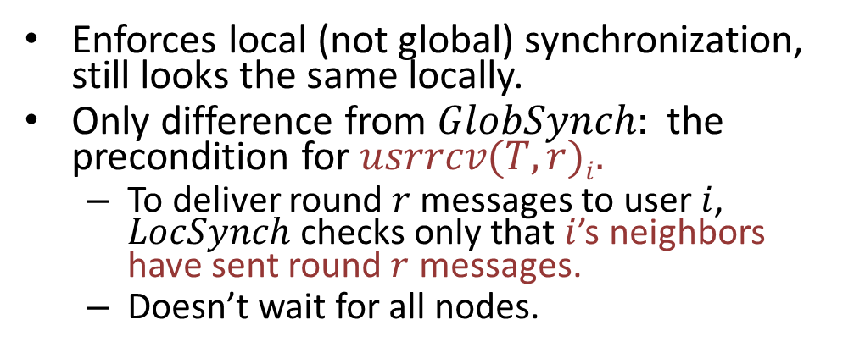
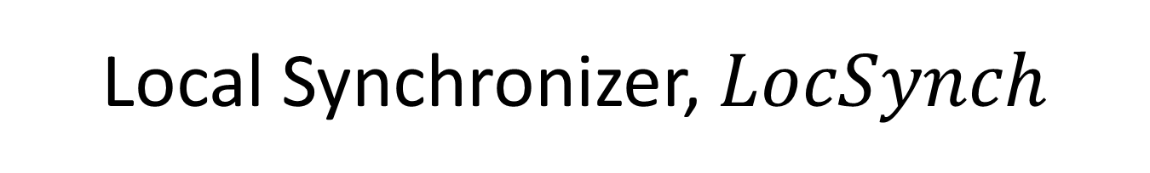
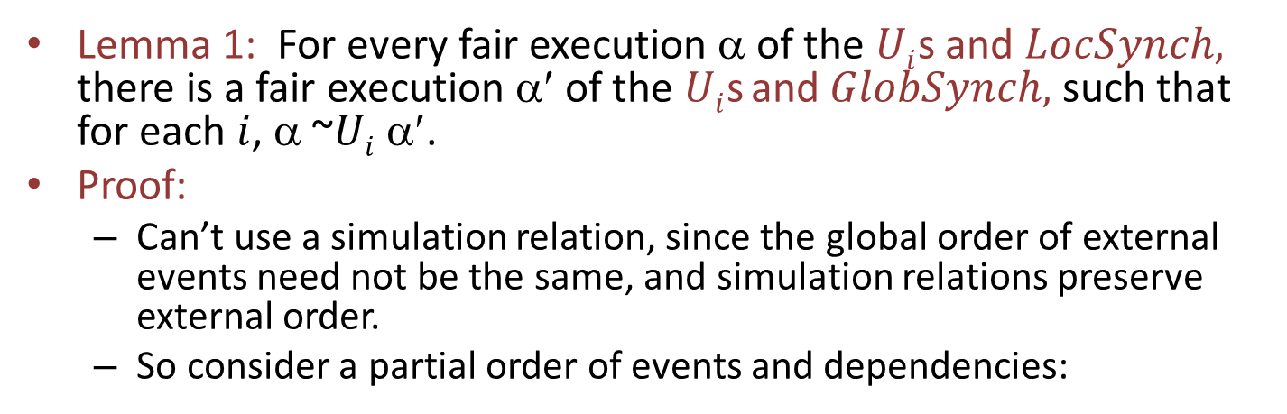
Local Synchronizer, $LocSynch$
Enforces local (not global) synchronization, still looks the same locally.
Only difference from $GlobSynch:$the precondition for $usrrcv(T,r)i.$
To deliver round $r$ messages to user $i$, $LocSynch$checks only that $i$’s neighbors have sent round $r$ messages.
Doesn’t wait for all nodes.
U₂
U₁
U_{n}
LocSynch
Lemma 1: For every fair execution α of the $Ui$s and $LocSynch,$ there is a fair execution α′ of the $Ui$s and $GlobSynch,$ such that for each $i$, α ~$Ui$α′.
Proof:
Can’t use a simulation relation, since the global order of external events need not be the same, and simulation relations preserve external order.
So consider a partial order of events and dependencies:

Slide 12
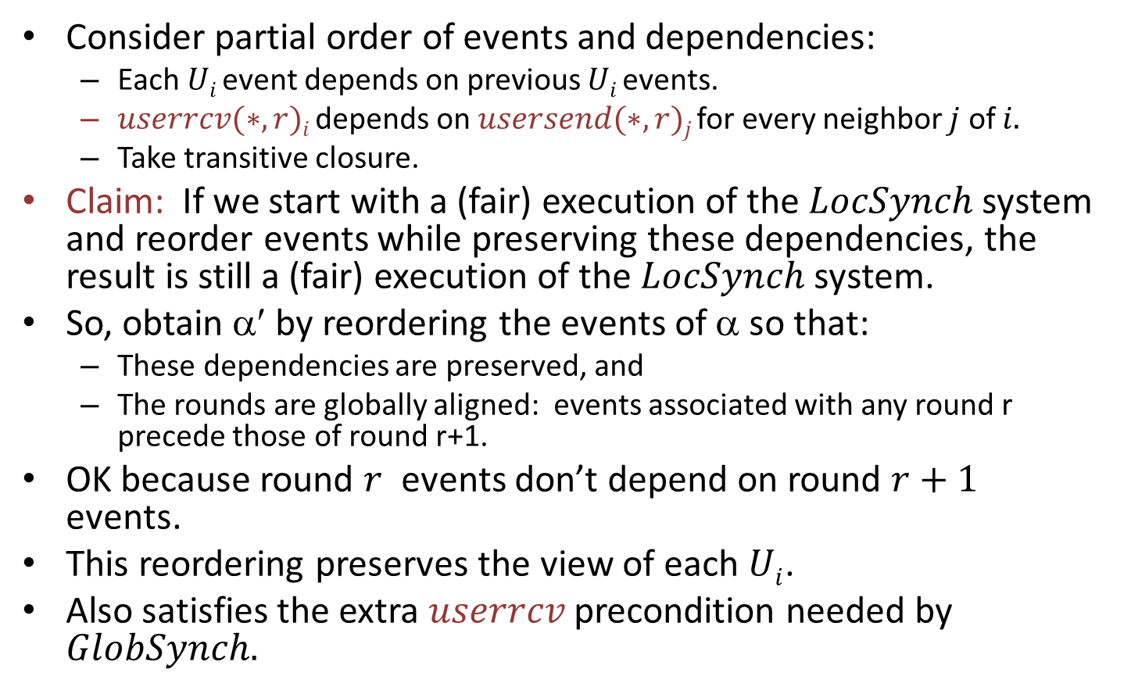
Proof sketch for Lemma 1
Consider partial order of events and dependencies:
Each $Ui$ event depends on previous $Ui$events.
$userrcv(∗,r)i$depends on $usersend(∗,r)j$for every neighbor $j$ of $i.$
Take transitive closure.
Claim: If we start with a (fair) execution of the $LocSynch$ system and reorder events while preserving these dependencies, the result is still a (fair) execution of the $LocSynch$ system.
So, obtain α′ by reordering the events of α so that:
These dependencies are preserved, and
The rounds are globally aligned: events associated with any round r precede those of round r+1.
OK because round $r$ events don’t depend on round $r+1$ events.
This reordering preserves the view of each $Ui$.
Also satisfies the extra $userrcv$ precondition needed by $GlobSynch.$
Notes:
A kind of causality ordering.
Claim holds because all preconditions are still true, well-formedness conditions are preserved.
We can verify that we can do this, because events of round r+1 never depend on events of round r (check the preconditions).
In other words, we can take any execution of the LocSynch system, reorder events as long as we don’t upset local dependencies, and we still have an execution of LocSynch. So reorder to align the rounds.

Slide 13
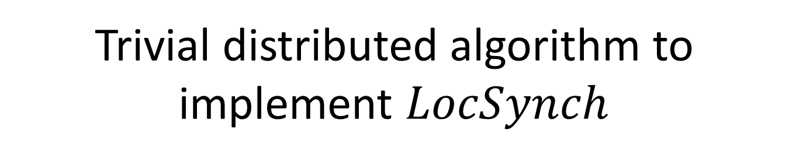
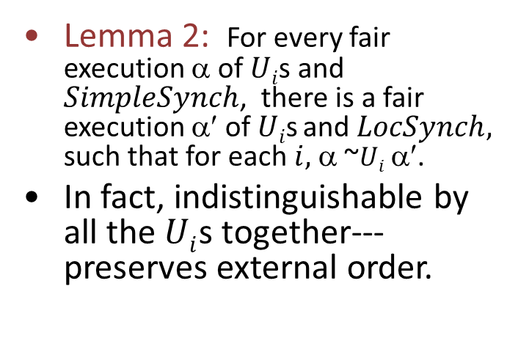
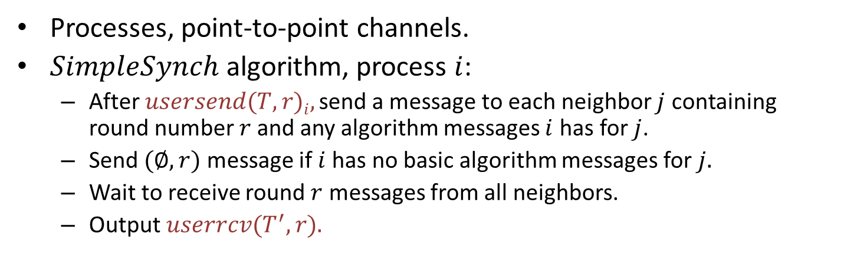
Trivial distributed algorithm to implement $LocSynch$
Processes, point-to-point channels.
$SimpleSynch$ algorithm, process $i$:
After $usersend(T,r)i,$ send a message to each neighbor $j$ containing round number $r$and any algorithm messages $i$ has for $j$.
Send $(∅,r)$ message if $i$has no basic algorithm messages for $j.$
Wait to receive round $r$ messages from all neighbors.
Output $userrcv(T^{′},r).$
Lemma 2: For every fair execution α of $Ui$s and $SimpleSynch$, there is a fair execution α′ of $Ui$s and $LocSynch,$ such that for each $i,$ α ~$Ui$ α′.
In fact, indistinguishable by all the $Ui$s together---preserves external order.
U₂
U₁
U_{n}
SimpleSynch
Notes:
So now the problem reduces to implementing the LocSynch local synchronizer spec, with a distributed algorithm.
The algorithm outputs the “right” T’.
Actually, Lemma 2 could be strengthened---looks the same to the COMPOSITION of all the Uis, that is, to all the Uis together.

Slide 14
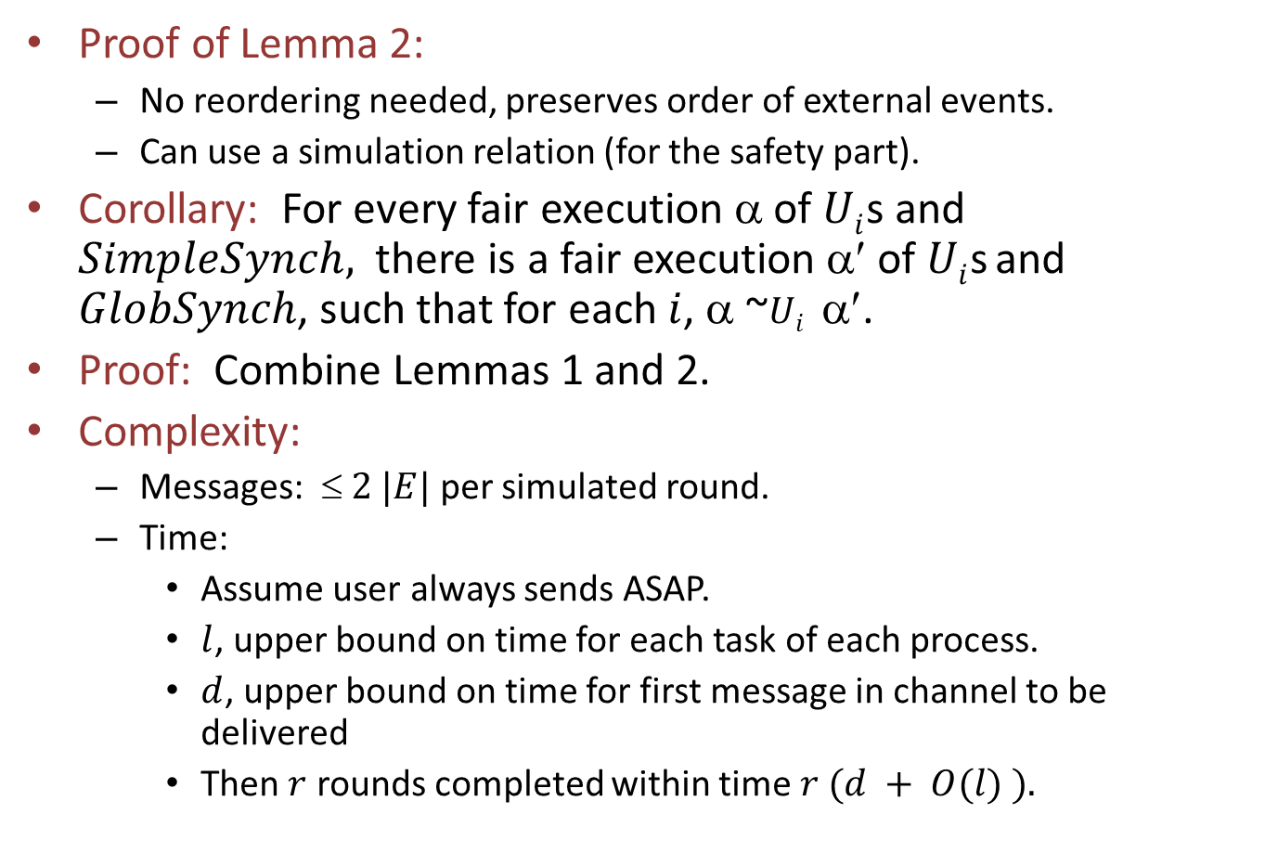
SimpleSynch, cont’d
Proof of Lemma 2:
No reordering needed, preserves order of external events.
Can use a simulation relation (for the safety part).
Corollary: For every fair execution α of $Ui$s and $SimpleSynch,$ there is a fair execution α′ of $Ui$s and $GlobSynch$, such that for each $i$, α ~$Ui$ α′.
Proof: Combine Lemmas 1 and 2.
Complexity:
Messages: $ 2 |E|$per simulated round.
Time:
Assume user always sends ASAP.
$l$, upper bound on time for each task of each process.
$d$, upper bound on time for first message in channel to be delivered
Then $r$ rounds completed within time $r (d + O(l) ).$
Notes:
Simulation relation for safety part, some ad hoc argument for liveness.
2 |E| because one message on each edge, in each direction. (Assume I’m counting undirected edges here.)

Slide 15
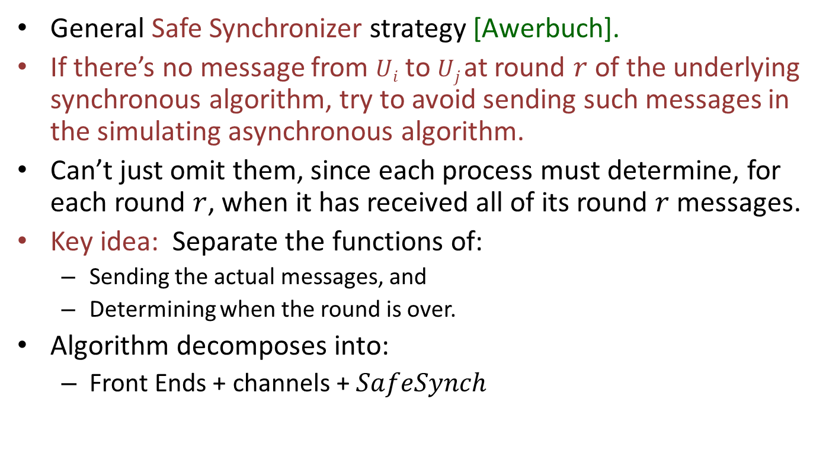
Reducing the communication
General Safe Synchronizer strategy [Awerbuch].
If there’s no message from $Ui$ to $Uj$at round $r$ of the underlying synchronous algorithm, try to avoid sending such messages in the simulating asynchronous algorithm.
Can’t just omit them, since each process must determine, for each round $r$, when it has received all of its round $r$ messages.
Key idea: Separate the functions of:
Sending the actual messages, and
Determining when the round is over.
Algorithm decomposes into:
Front Ends + channels + $SafeSynch$
U₁
U₂
FE₁
FE₂
OK
GO
OK
GO
SafeSynch
For the actual messages
For deciding when
round is finished
Notes:
Front Ends will handle the actual messages, whereas the SafeSynch will determine when the rounds are finished.

Slide 16
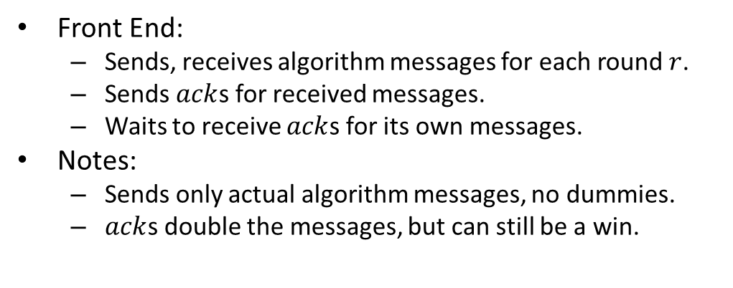
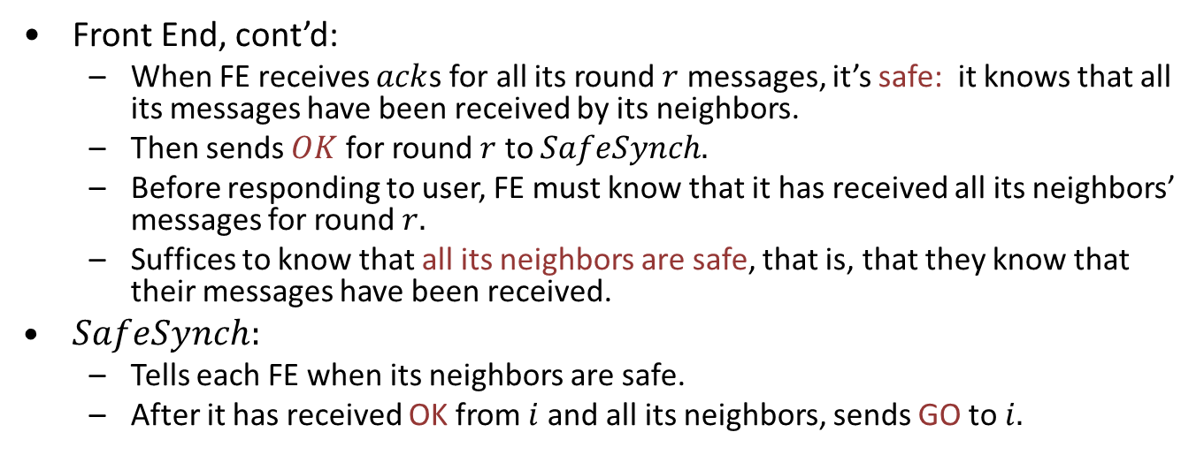
Safe Synchronizers
Front End:
Sends, receives algorithm messages for each round $r$.
Sends $ack$s for received messages.
Waits to receive $ack$s for its own messages.
Notes:
Sends only actual algorithm messages, no dummies.
$ack$s double the messages, but can still be a win.
U₁
U₂
FE₁
FE₂
OK
GO
OK
GO
SafeSynch
Front End, cont’d:
When FE receives $ack$s for all its round $r$ messages, it’s safe: it knows that all its messages have been received by its neighbors.
Then sends $OK$ for round $r$ to $SafeSynch.$
Before responding to user, FE must know that it has received all its neighbors’ messages for round $r.$
Suffices to know that all its neighbors are safe, that is, that they know that their messages have been received.
$SafeSynch:$
Tells each FE when its neighbors are safe.
After it has received OK from $i$ and all its neighbors, sends GO to $i.$
Notes:
If actual messages are “sparse” this can still be a win.

Slide 17
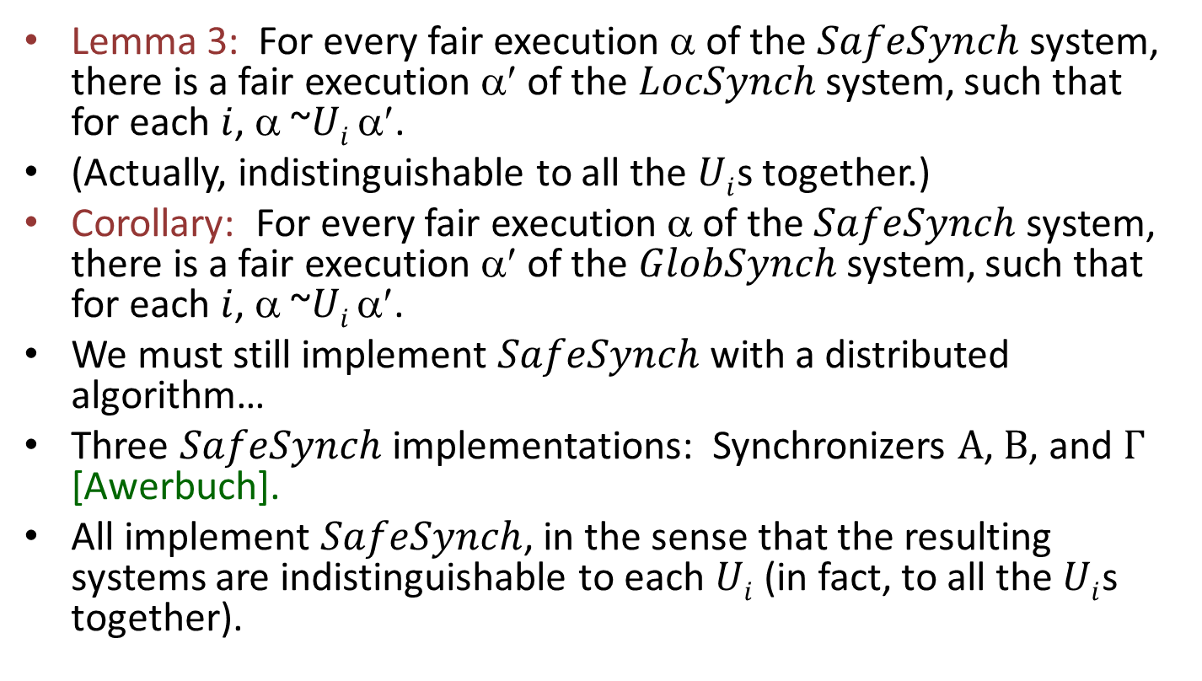
Correctness of SafeSynch
Lemma 3: For every fair execution α of the $SafeSynch$ system, there is a fair execution α′ of the $LocSynch$ system, such that for each $i$, α ~$Ui$ α′.
(Actually, indistinguishable to all the $Ui$s together.)
Corollary: For every fair execution α of the $SafeSynch$system, there is a fair execution α′ of the $GlobSynch$ system, such that for each $i$, α ~$Ui$α′.
We must still implement $SafeSynch$ with a distributed algorithm…
Three $SafeSynch$ implementations: Synchronizers $Α$, $Β$, and $Γ$ [Awerbuch].
All implement $SafeSynch$, in the sense that the resulting systems are indistinguishable to each $Ui$(in fact, to all the $Ui$s together).

Slide 18
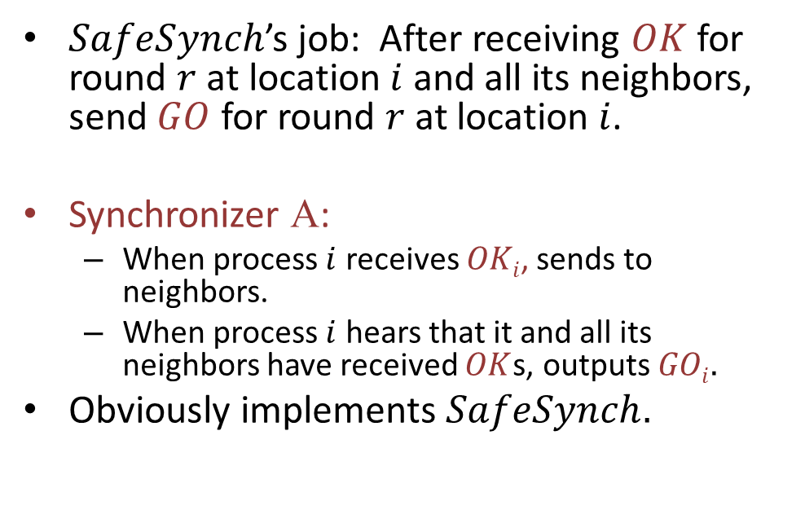
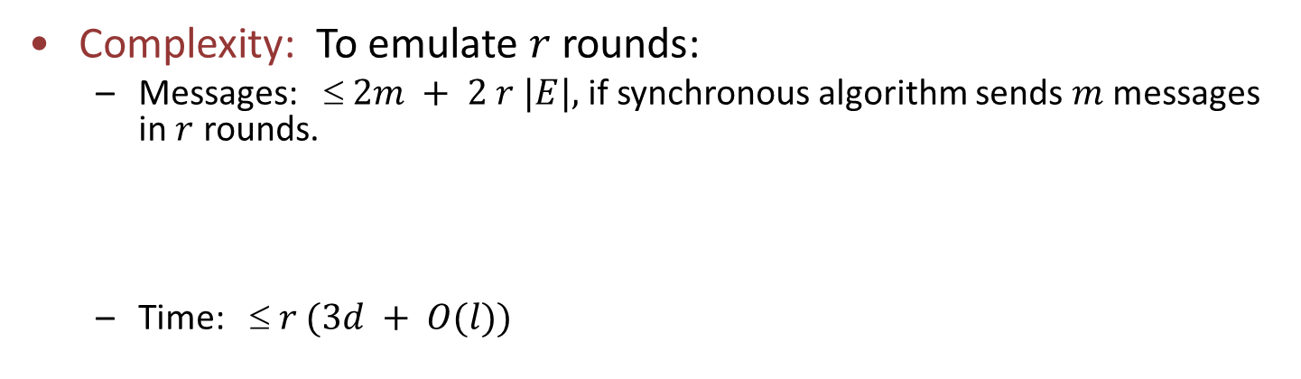
SafeSynch Implementations
$SafeSynch$’s job: After receiving $OK$ for round $r$ at location $i$ and all its neighbors, send $GO$ for round $r$ at location $i$.
Synchronizer Α:
When process $i$ receives $OKi$, sends to neighbors.
When process $i$ hears that it and all its neighbors have received $OK$s, outputs $GOi.$
Obviously implements $SafeSynch.$
U₁
U₂
FE₁
FE₂
OK
GO
OK
GO
Α
Complexity: To emulate $r$ rounds:
Messages: ≤ $2m + 2 r |E|,$if synchronous algorithm sends $m$ messages in $r$ rounds.
Time: ≤ $r (3d + O(l))$
msgs
Messages and acks by FEs
Messages within Α
FE
acks
Α
report-OK
Notes:
Implements SS, in the context of the other components.
Could show using a simulation relation.
Assume the synchronous algorithm sends m messages in r rounds.

Slide 19
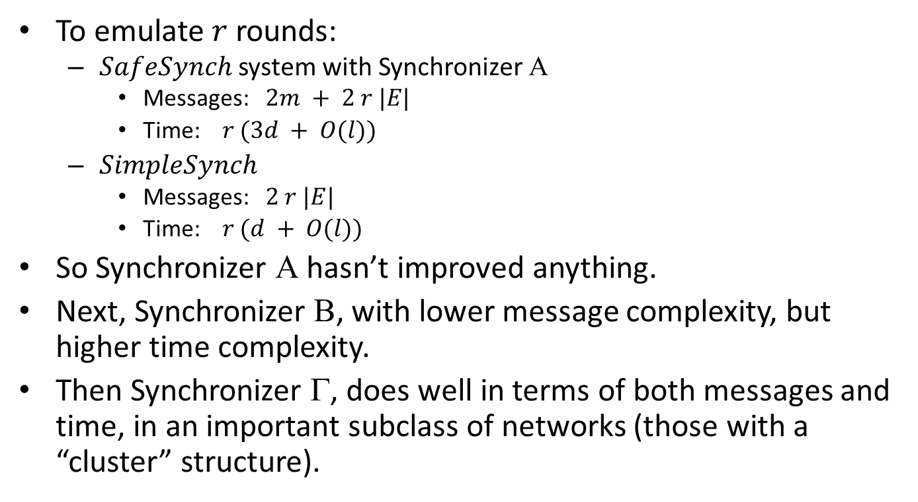
Comparisons
To emulate $r$ rounds:
$SafeSynch$ system with Synchronizer Α
Messages: $2m + 2 r |E|$
Time: $r (3d + O(l))$
$SimpleSynch$
Messages: $2 r |E|$
Time: $r (d + O(l))$
So Synchronizer Α hasn’t improved anything.
Next, Synchronizer Β, with lower message complexity, but higher time complexity.
Then Synchronizer Γ, does well in terms of both messages and time, in an important subclass of networks (those with a “cluster” structure).
Notes:
Mohsen Ghaffari’s class on Friday covered distributed algorithms for establishing good cluster structures in graph networks.

Slide 20
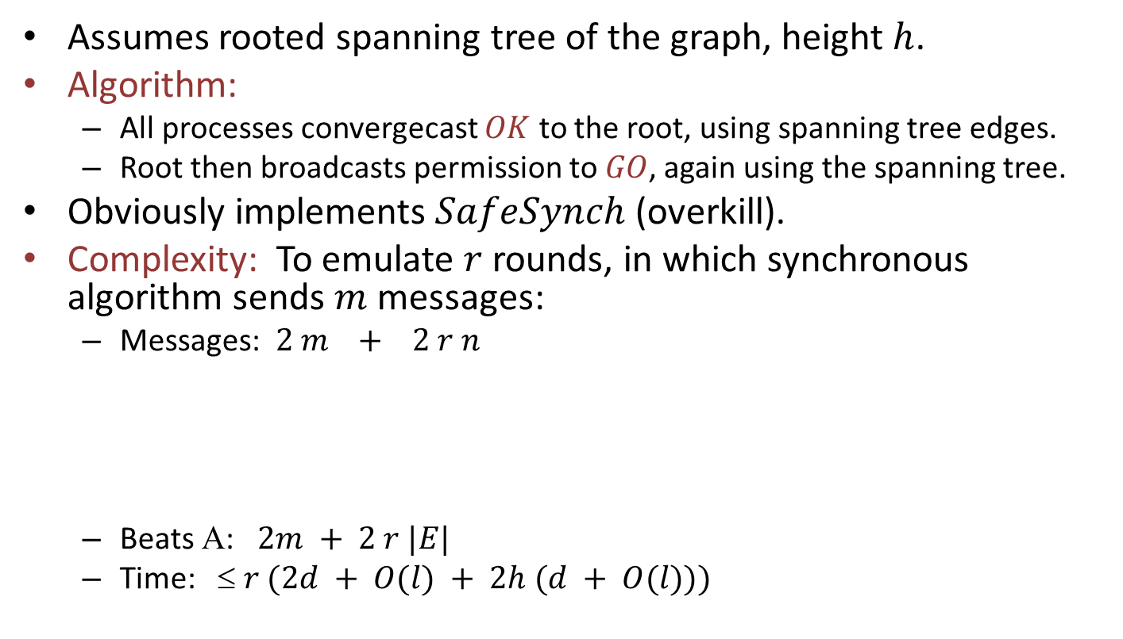

Synchronizer Β
Assumes rooted spanning tree of the graph, height $h$.
Algorithm:
All processes convergecast $OK$ to the root, using spanning tree edges.
Root then broadcasts permission to $GO$, again using the spanning tree.
Obviously implements $SafeSynch$ (overkill).
Complexity: To emulate $r$ rounds, in which synchronous algorithm sends $m$ messages:
Messages: $2 m + 2 r n$
Beats Α: $2m + 2 r |E|$
Time: ≤ $r (2d + O(l) + 2h (d + O(l)))$
Messages and acks by $FE$s
Messages within Β
FEs
Β, convergecast and broadcast
Notes:
It’s overkill because we’re really doing a global synchronization, not just local.
B beats A in terms of messages, but can be much worse in terms of time.

Slide 21
Synchronizer Γ
Hybrid of Α and Β.
In “clustered” (almost partitionable) graphs, can get performance advantages of both:
Time like Α, communication like Β.
Assume spanning forest of rooted trees, each tree spanning a “cluster” of nodes.
Example:
Clusters = triangles
All edges between
adjacent triangles in the line.
Spanning forest:
Use Β within each cluster, Α between clusters.

Slide 22
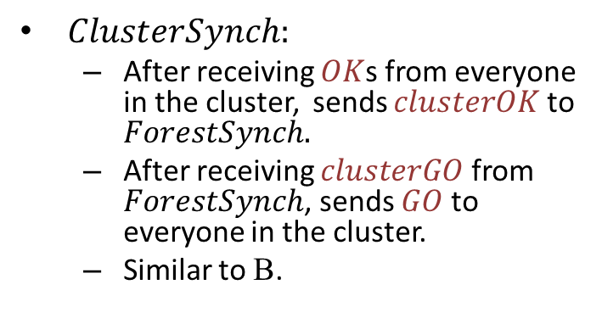
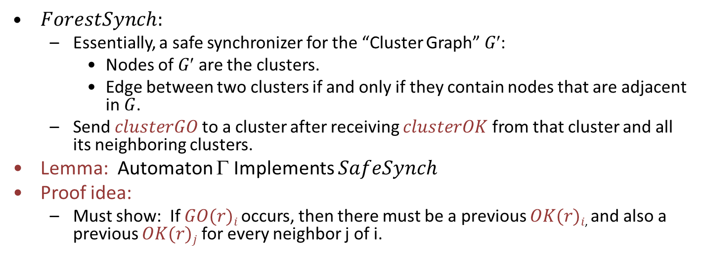
Decomposition of Γ
$ClusterSynch:$
After receiving $OK$s from everyone in the cluster, sends $clusterOK$ to $ForestSynch.$
After receiving $clusterGO$ from $ForestSynch$, sends $GO$ to everyone in the cluster.
Similar to Β.
GO
OK
OK
GO
ClusterSynch
ClusterSynch
ForestSynch
SafeSynch
$ForestSynch:$
Essentially, a safe synchronizer for the “Cluster Graph” $G$:
Nodes of $G$ are the clusters.
Edge between two clusters if and only if they contain nodes that are adjacent in $G$.
Send $clusterGO$to a cluster after receiving $clusterOK$ from that cluster and all its neighboring clusters.
Lemma: Automaton Γ Implements $SafeSynch$
Proof idea:
Must show: If $GO(r)i$ occurs, then there must be a previous $OK(r)i$, and also a previous $OK(r)j$ for every neighbor j of i.
Notes:
Another level of abstract decomposition into lower-level specification automata (the analog of subroutines).
Here the automaton Gamma refers to the composition of these abstract specification automata.

Slide 23
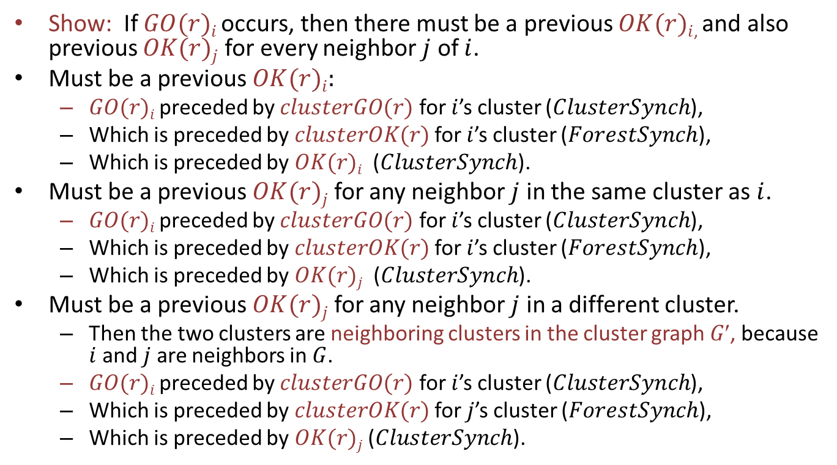
Γ Implements SafeSynch
Show: If $GO(r)i$ occurs, then there must be a previous $OK(r)i$, and also previous $OK(r)j$ for every neighbor $j$ of $i$.
Must be a previous $OK(r)i:$
$GO(r)i$ preceded by $clusterGO(r)$ for $i$’s cluster ($ClusterSynch$),
Which is preceded by $clusterOK(r)$ for $i$’s cluster ($ForestSynch$),
Which is preceded by $OK(r)i$ ($ClusterSynch$).
Must be a previous $OK(r)j$ for any neighbor $j$ in the same cluster as $i$.
$GO(r)i$ preceded by $clusterGO(r)$ for $i$’s cluster ($ClusterSynch$),
Which is preceded by $clusterOK(r)$ for $i$’s cluster ($ForestSynch$),
Which is preceded by $OK(r)j$ ($ClusterSynch$).
Must be a previous $OK(r)j$ for any neighbor $j$ in a different cluster.
Then the two clusters are neighboring clusters in the cluster graph $G$, because $i$ and $j$ are neighbors in $G$.
$GO(r)i$ preceded by $clusterGO(r)$ for $i$’s cluster ($ClusterSynch$),
Which is preceded by $clusterOK(r)$ for $j$’s cluster ($ForestSynch$),
Which is preceded by $OK(r)j$ ($ClusterSynch$).

Slide 24
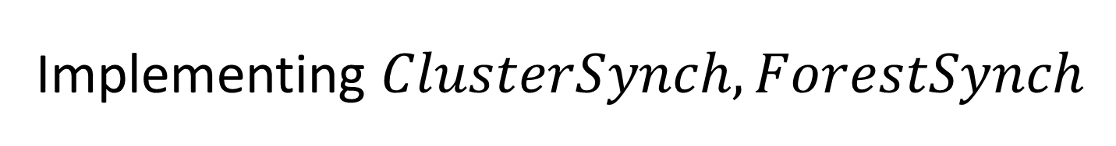
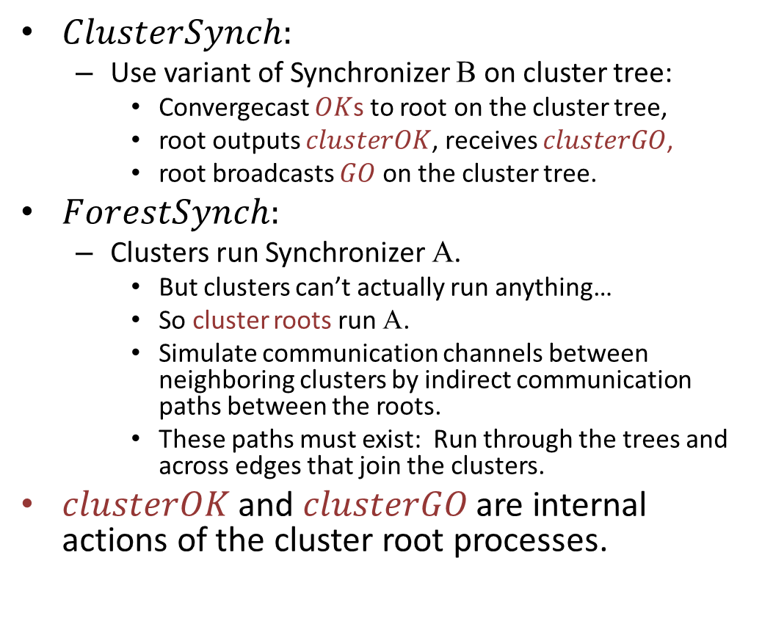
Implementing $ClusterSynch, ForestSynch$
$ClusterSynch:$
Use variant of Synchronizer Β on cluster tree:
Convergecast $OK$s to root on the cluster tree,
root outputs $clusterOK$, receives $clusterGO$,
root broadcasts $GO$ on the cluster tree.
$ForestSynch:$
Clusters run Synchronizer Α.
But clusters can’t actually run anything…
So cluster roots run Α.
Simulate communication channels between neighboring clusters by indirect communication paths between the roots.
These paths must exist: Run through the trees and across edges that join the clusters.
$clusterOK$ and $clusterGO$ are internal actions of the cluster root processes.
Notes:
We still need distributed algorithms for these.

Slide 25
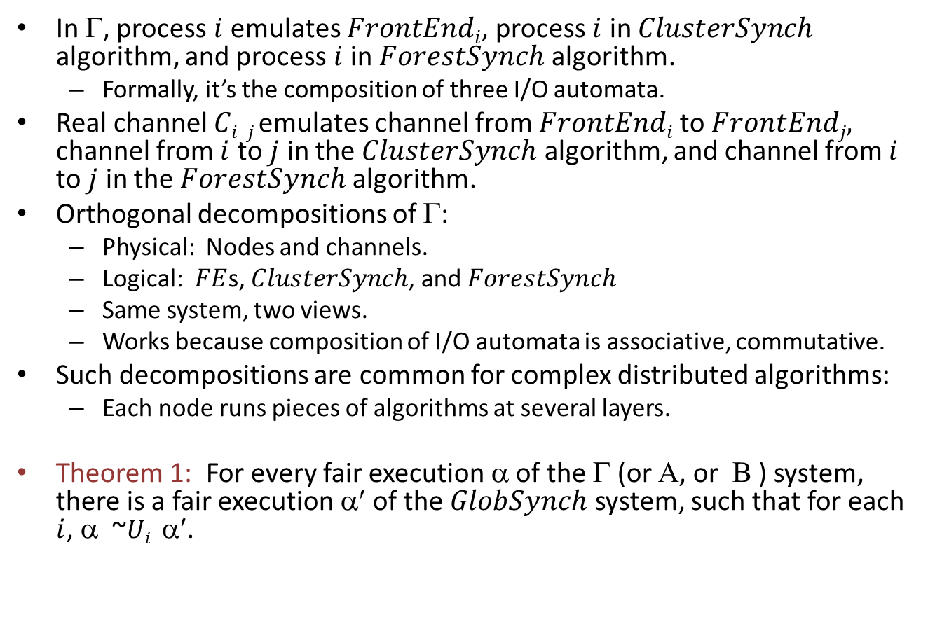
Putting the pieces together
In Γ, process $i$ emulates $FrontEndi$, process $i$ in $ClusterSynch$ algorithm, and process $i$ in $ForestSynch$ algorithm.
Formally, it’s the composition of three I/O automata.
Real channel $Ci,j$emulates channel from $FrontEndi$to $FrontEndj,$ channel from $i$ to $j$ in the $ClusterSynch$ algorithm, and channel from $i$ to $j$ in the $ForestSynch$ algorithm.
Orthogonal decompositions of Γ:
Physical: Nodes and channels.
Logical: $FE$s, $ClusterSynch$, and $ForestSynch$
Same system, two views.
Works because composition of I/O automata is associative, commutative.
Such decompositions are common for complex distributed algorithms:
Each node runs pieces of algorithms at several layers.
Theorem 1: For every fair execution α of the Γ (or Α, or Β ) system, there is a fair execution α′ of the $GlobSynch$ system, such that for each $i$, α ~$Ui$ α′.
Notes:
Lemma 4: For every fair execution α of complete Γ system, there is a fair execution α′ of LocSynch system, such that for each U_{i}, α ~U_{i} α′.
Lemma 4: Actually indist to all the users together.

Slide 26

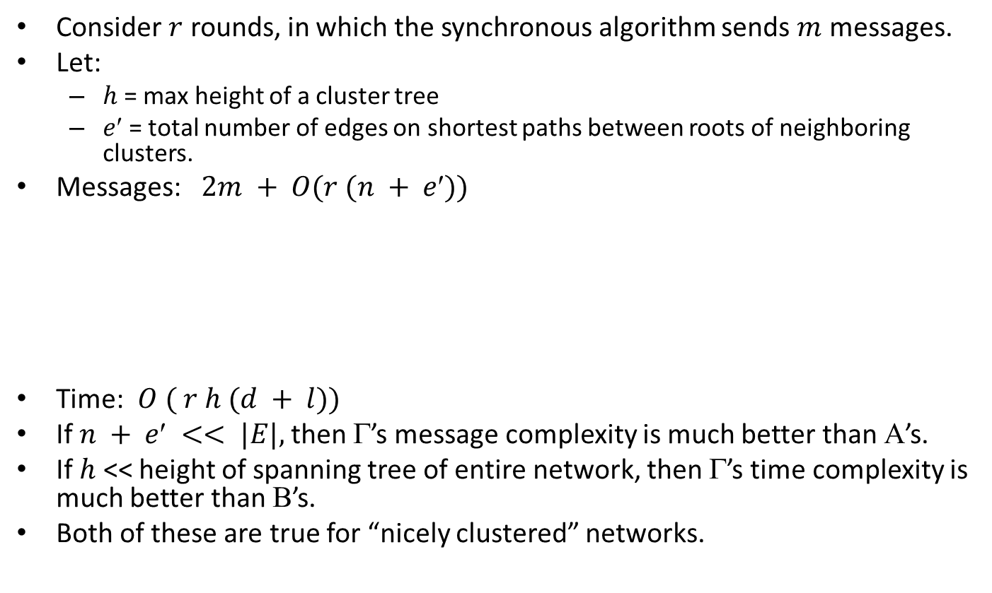
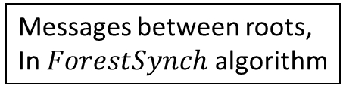
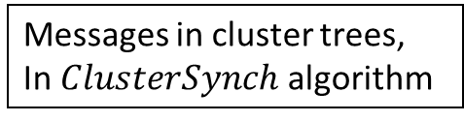
Complexity of Γ
Consider $r$ rounds, in which the synchronous algorithm sends $m$ messages.
Let:
$h$= max height of a cluster tree
$e$ = total number of edges on shortest paths between roots of neighboring clusters.
Messages: $2m + O(r (n + e))$
Time: $O ( r h (d + l))$
If $n + e << |E|,$then Γ’s message complexity is much better than Α’s.
If $h$ << height of spanning tree of entire network, then Γ’s time complexity is much better than Β’s.
Both of these are true for “nicely clustered” networks.
Messages between roots,
In $ForestSynch$ algorithm
Messages and acks by $FE$s
Messages in cluster trees,
In $ClusterSynch$ algorithm

Slide 27
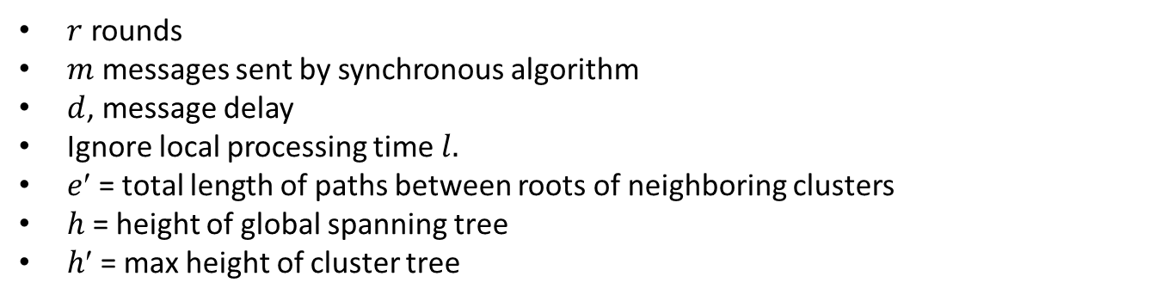
Comparison of Costs
$r$ rounds
$m$ messages sent by synchronous algorithm
$d$, message delay
Ignore local processing time $l.$
$e$ = total length of paths between roots of neighboring clusters
$h$ = height of global spanning tree
$h$ = max height of cluster tree
Messages
Time
Α
2 m + 2 r |E|
O( r d )
Β
2 m + 2 r n
O( r h d )
Γ
2 m + O( r (n + e′))
O( r h′ d )

Slide 28
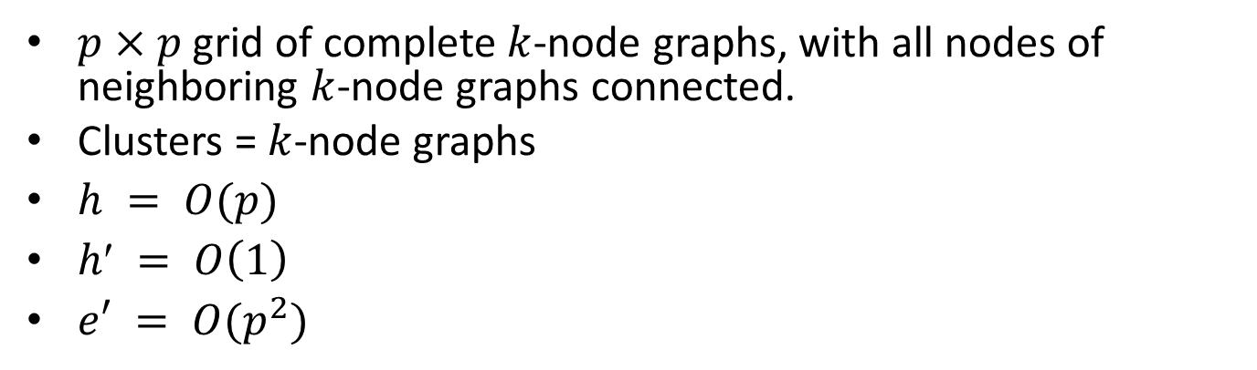
Example
$p×p$grid of complete $k$-node graphs, with all nodes of neighboring $k$-node graphs connected.
Clusters = $k$-node graphs
$h = O(p)$
$h′ = O\left(1\right)$
$e′ = O(p^{2})$
Messages
Time
Α
2 m + O( r p² k² )
O( r d )
Β
2 m + O( r p² k )
O( r p d )
Γ
2 m + O( r p² k)
O( r d )
Notes:
The clusters are the k-graphs.

Slide 29
Synchronizer Applications

Slide 30
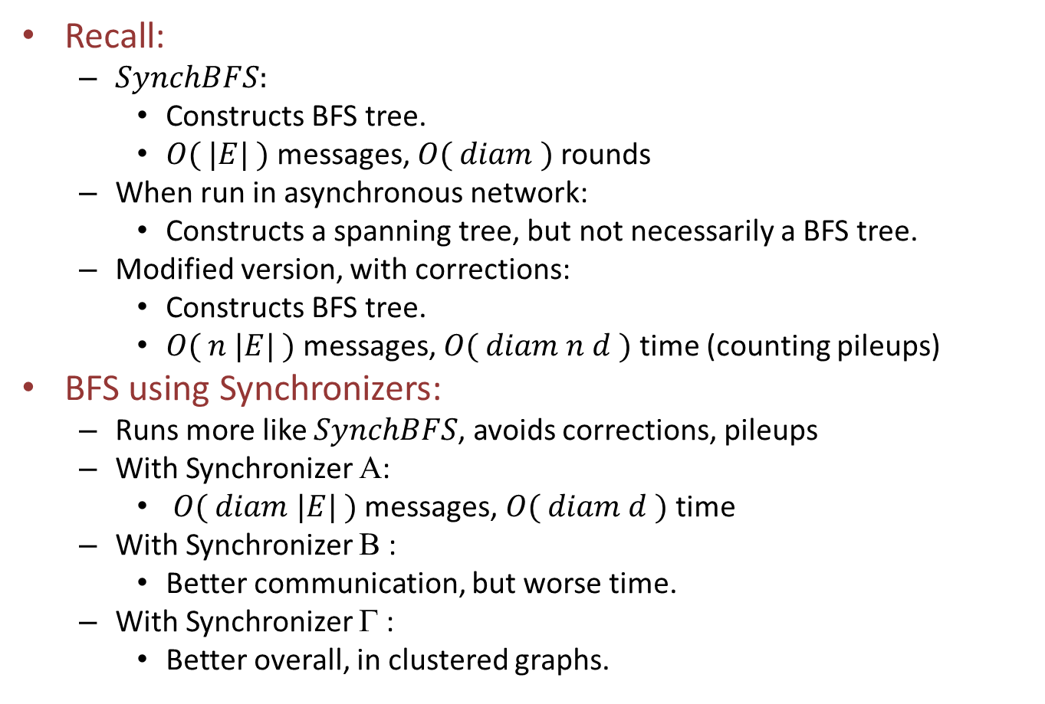
Application 1: Breadth-First Search
Recall:
$SynchBFS:$
Constructs BFS tree.
$O( |E| )$messages, $O( diam )$rounds
When run in asynchronous network:
Constructs a spanning tree, but not necessarily a BFS tree.
Modified version, with corrections:
Constructs BFS tree.
$O( n |E| )$messages, $O( diam n d )$time (counting pileups)
BFS using Synchronizers:
Runs more like $SynchBFS$, avoids corrections, pileups
With Synchronizer Α:
$O( diam |E| )$messages, $O( diam d )$time
With Synchronizer Β :
Better communication, but worse time.
With Synchronizer Γ :
Better overall, in clustered graphs.
Notes:
Ignoring local processing time here.
Ignoring termination.
Could stop after diam rounds, if know diam.
Or could stop after outputting parent and sending messages on to all neighbors.

Slide 31
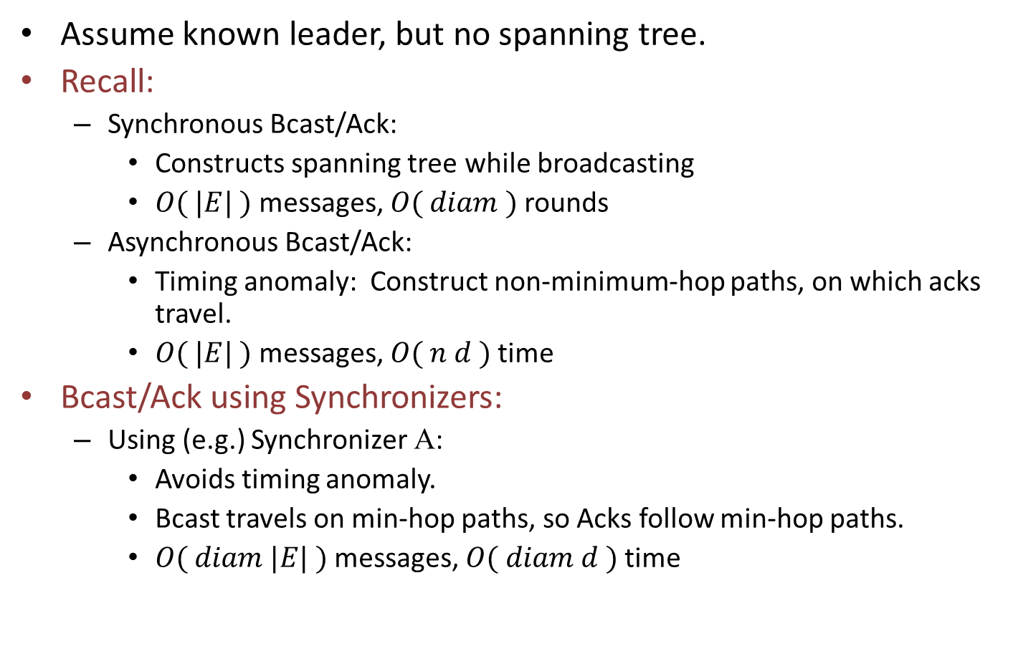
Application 2: Broadcast/Ack
Assume known leader, but no spanning tree.
Recall:
Synchronous Bcast/Ack:
Constructs spanning tree while broadcasting
$O( |E| )$messages, $O( diam )$rounds
Asynchronous Bcast/Ack:
Timing anomaly: Construct non-minimum-hop paths, on which acks travel.
$O( |E| )$messages, $O( n d )$time
Bcast/Ack using Synchronizers:
Using (e.g.) Synchronizer Α:
Avoids timing anomaly.
Bcast travels on min-hop paths, so Acks follow min-hop paths.
$O( diam |E| )$messages, $O( diam d )$time

Slide 32
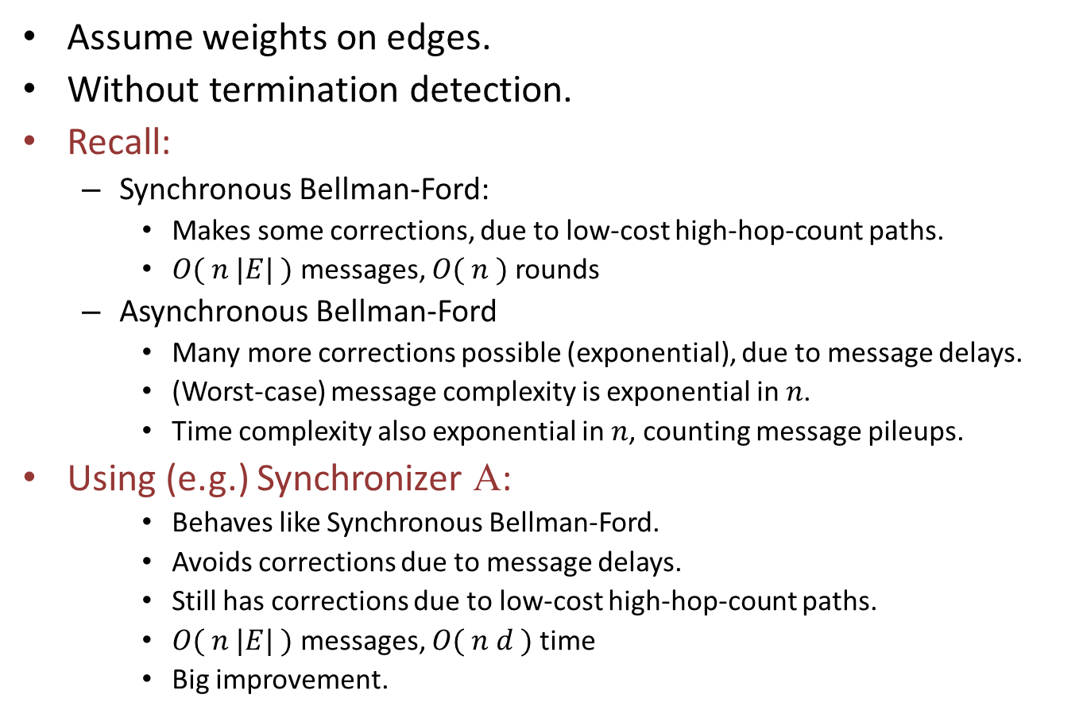
Application 3: Shortest paths
Assume weights on edges.
Without termination detection.
Recall:
Synchronous Bellman-Ford:
Makes some corrections, due to low-cost high-hop-count paths.
$O( n |E| )$messages, $O( n )$rounds
Asynchronous Bellman-Ford
Many more corrections possible (exponential), due to message delays.
(Worst-case) message complexity is exponential in $n$.
Time complexity also exponential in $n$, counting message pileups.
Using (e.g.) Synchronizer Α:
Behaves like Synchronous Bellman-Ford.
Avoids corrections due to message delays.
Still has corrections due to low-cost high-hop-count paths.
$O( n |E| )$messages, $O( n d )$time
Big improvement.
Notes:
This is without termination detection.
Could terminate after n rounds if know n.
Probably could fan in for termination, as in the asynch shortest paths algorithm---needs working out.

Slide 33
Further reading
To read more:
See Awerbuch’s extensive work on
Applications of synchronizers.
Distributed algorithms for clustered networks.
Also work by Peleg.
[Awerbuch, Peleg] Dijkstra Prize paper on clustered networks.
Q: This work used a strategy of purposely slowing down portions of a system in order to improve overall performance. In which situations is this strategy a win?
Notes:
This is an open-ended question.
Something to think about.

Slide 34
Lower Bound on Time for Synchronization
flash₂
flash₁
flash_{n}
A

Slide 35
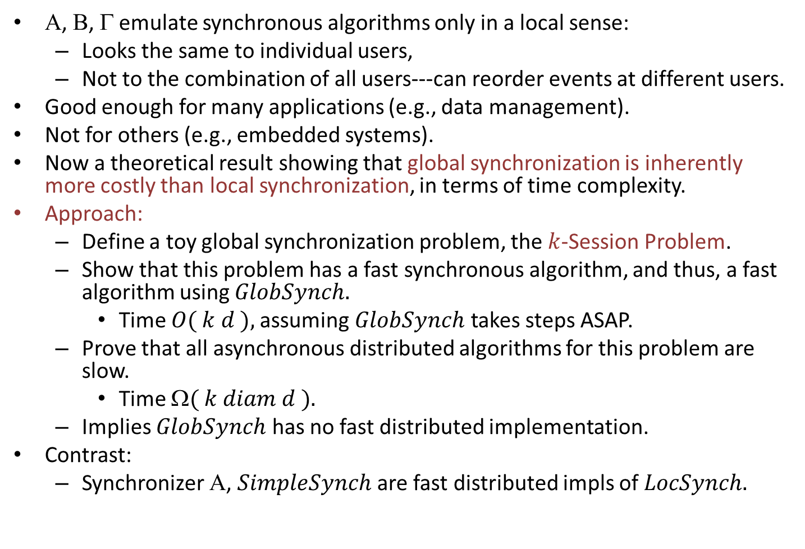
Lower bound on time for synchronization
Α, Β, Γ emulate synchronous algorithms only in a local sense:
Looks the same to individual users,
Not to the combination of all users---can reorder events at different users.
Good enough for many applications (e.g., data management).
Not for others (e.g., embedded systems).
Now a theoretical result showing that global synchronization is inherently more costly than local synchronization, in terms of time complexity.
Approach:
Define a toy global synchronization problem, the $k$-Session Problem.
Show that this problem has a fast synchronous algorithm, and thus, a fast algorithm using $GlobSynch.$
Time $O( k d ),$assuming $GlobSynch$ takes steps ASAP.
Prove that all asynchronous distributed algorithms for this problem are slow.
Time $( k diam d ).$
Implies $GlobSynch$ has no fast distributed implementation.
Contrast:
Synchronizer Α, $SimpleSynch$ are fast distributed impls of $LocSynch.$
Notes:
Embedded systems interact with the real world, so the order of events at different locations may matter---may affect real-world phenomena.

Slide 36

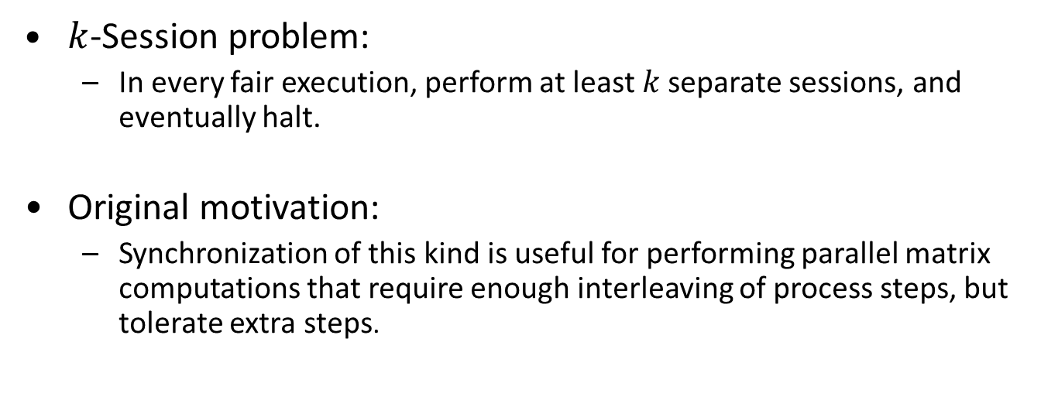
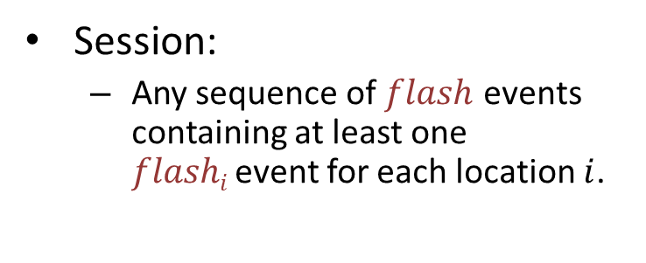
$k$-Session Problem
flash₂
Session:
Any sequence of $flash$ events containing at least one $flashi$event for each location $i$.
flash₁
flash_{n}
$k$-Session problem:
In every fair execution, perform at least $k$separate sessions, and eventually halt.
Original motivation:
Synchronization of this kind is useful for performing parallel matrix computations that require enough interleaving of process steps, but tolerate extra steps.
Notes:
Original motivation came from PRAM parallel algorithms, Arjomandi.

Slide 37
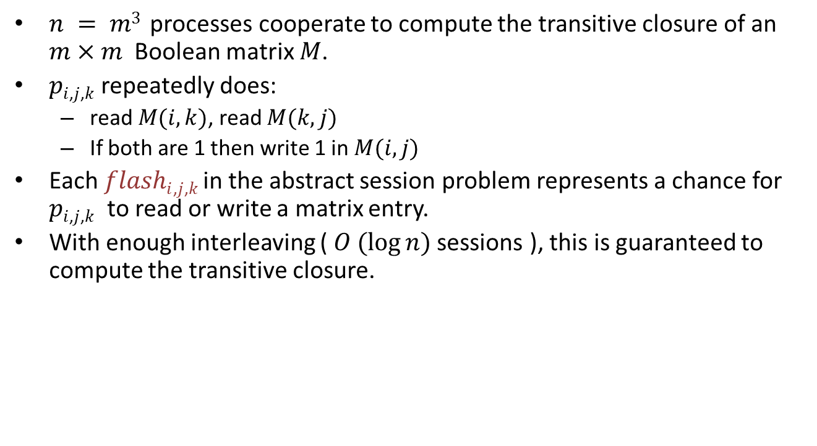
Application: Boolean matrix computation
$n = m3$ processes cooperate to compute the transitive closure of an $m×m$Boolean matrix $M$.
$pi$,$j$,$k$ repeatedly does:
read $M(i,k)$, read $M(k,j)$
If both are 1 then write 1 in $M(i,j)$
Each $flashi$,$j$,$k$in the abstract session problem represents a chance for $pi$,$j$,$k$ to read or write a matrix entry.
With enough interleaving ( $O (log⁡n)$sessions ), this is guaranteed to compute the transitive closure.
flash₂
flash₁
flash_{n}
Notes:
The processes must communicate somehow, to make sure they guarantee enough interleaving. I’ll pretend here that they communicate using a network, though in the original example, they used shared memory.

Slide 38

Synchronous solution
Fast algorithm using $GlobSynch$:
Just flash once at every round.
$k$ sessions done in time $O( k d ),$assuming $GlobSynch$ takes steps ASAP.
flash₂
flash₁
flash_{n}
U₂
U₁
U_{n}
GlobSynch
Notes:
This works because GlobSynch synchronizes between each pair of consecutive rounds; thus we get separate sessions.

Slide 39
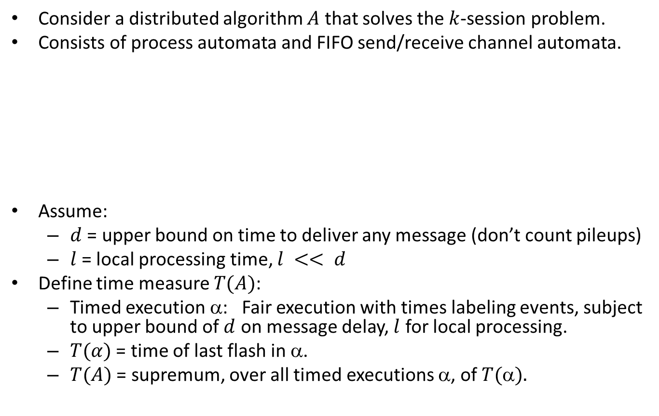
Asynchronous lower bound
Consider a distributed algorithm $A$ that solves the $k$-session problem.
Consists of process automata and FIFO send/receive channel automata.
Assume:
$d$ = upper bound on time to deliver any message (don’t count pileups)
$l$= local processing time, $l << d$
Define time measure $T(A)$:
Timed execution α: Fair execution with times labeling events, subject to upper bound of $d$ on message delay, $l$ for local processing.
$T(α)$ = time of last flash in α.
$T(A)$ = supremum, over all timed executions α, of $T().$
flash₂
flash₁
flash_{n}
A
Notes:
We’re going to ignore the l terms in the lower bound.

Slide 40
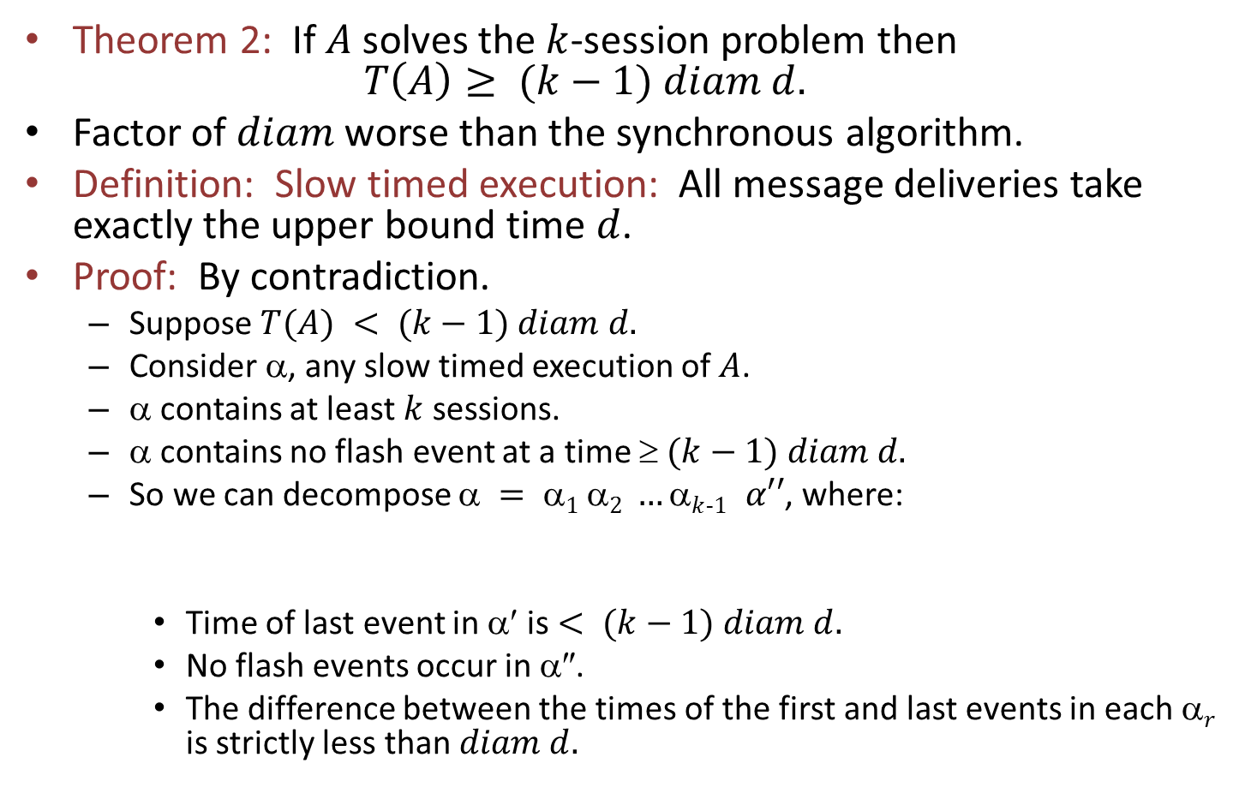
Lower bound
Theorem 2: If $A$ solves the $k$-session problem then $T\left(A\right)≥ (k−1) diam d.$
Factor of $diam$ worse than the synchronous algorithm.
Definition: Slow timed execution: All message deliveries take exactly the upper bound time $d$.
Proof: By contradiction.
Suppose $T(A) < (k−1) diam d.$
Consider α, any slow timed execution of $A$.
α contains at least $k$ sessions.
α contains no flash event at a time $ (k−1) diam d.$
So we can decompose $ = 1 2 …k$₋$1 α′′$, where:
Time of last event in α′ is $< (k−1) diam d.$
No flash events occur in α″.
The difference between the times of the first and last events in each α$r$ is strictly less than $diam d.$
α′

Slide 41
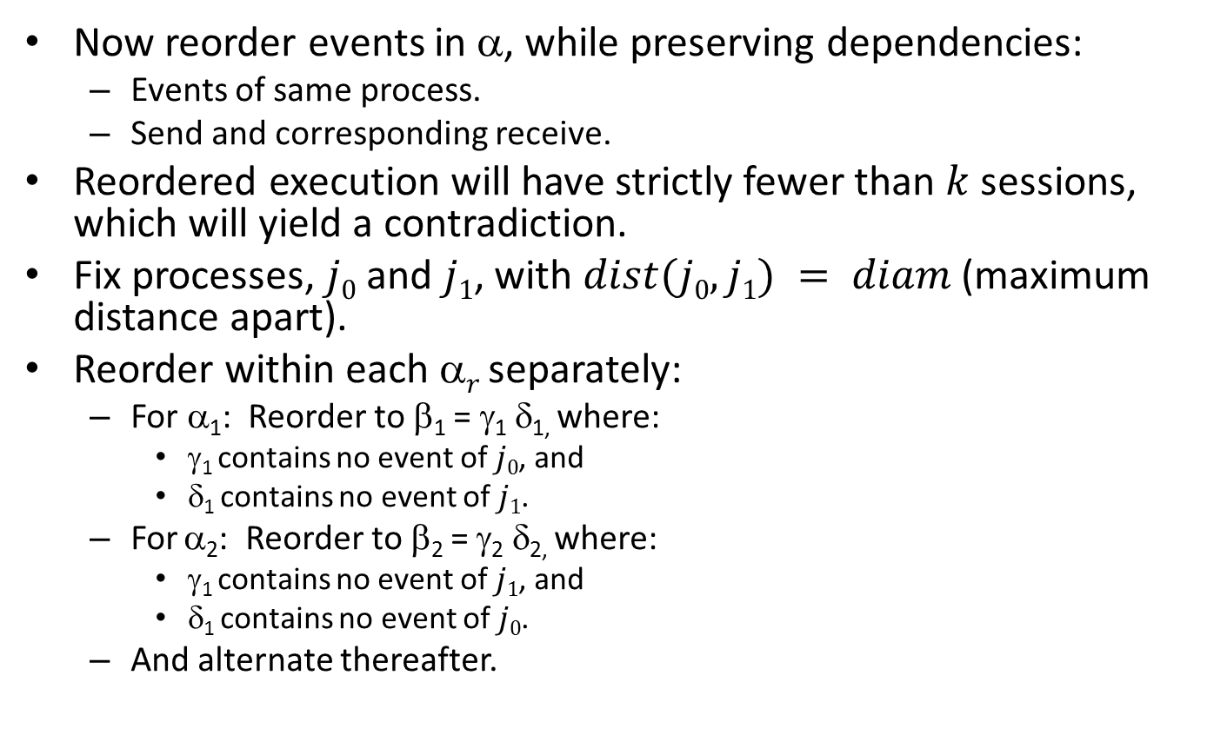
Lower bound, cont’d
Now reorder events in α, while preserving dependencies:
Events of same process.
Send and corresponding receive.
Reordered execution will have strictly fewer than $k$ sessions, which will yield a contradiction.
Fix processes, $j0$ and $j1$, with $dist(j0,j1) = diam$ (maximum distance apart).
Reorder within each α$r$ separately:
For α₁: Reorder to β₁ = γ₁ δ_{1,} where:
γ₁ contains no event of $j0$, and
δ₁ contains no event of $j1$.
For α₂: Reorder to β₂ = γ₂ δ_{2,} where:
γ₁ contains no event of $j1$, and
δ₁ contains no event of $j0$.
And alternate thereafter.

Slide 42
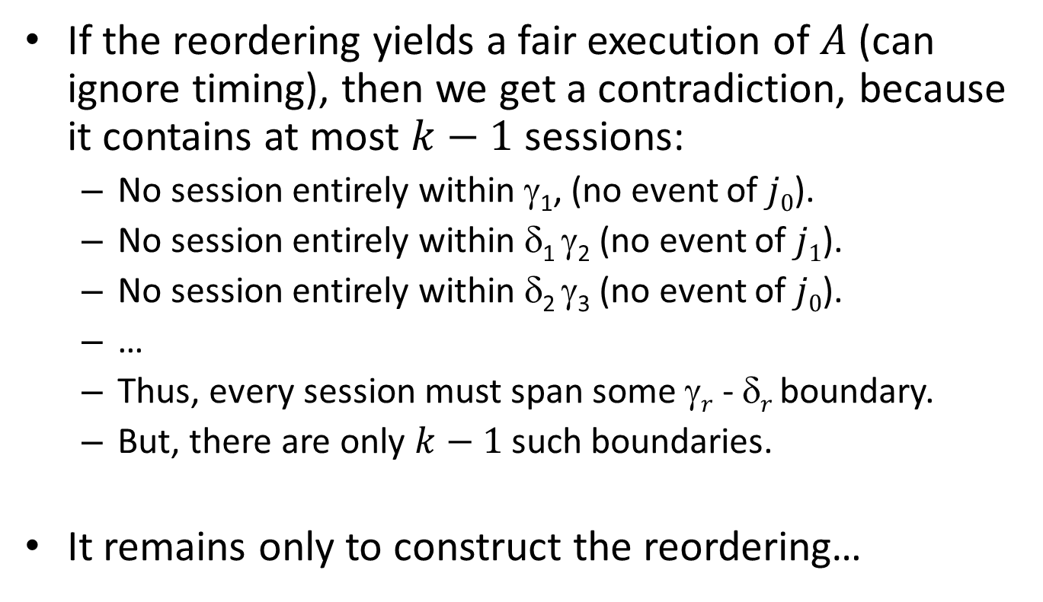
Lower bound, cont’d
If the reordering yields a fair execution of $A$(can ignore timing), then we get a contradiction, because it contains at most $k−1$ sessions:
No session entirely within γ₁, (no event of $j0$).
No session entirely within δ₁ γ₂ (no event of $j1$).
No session entirely within δ₂ γ₃ (no event of $j0$).
…
Thus, every session must span some γ$r$ - δ$r$ boundary.
But, there are only $k−1$ such boundaries.
It remains only to construct the reordering…

Slide 43
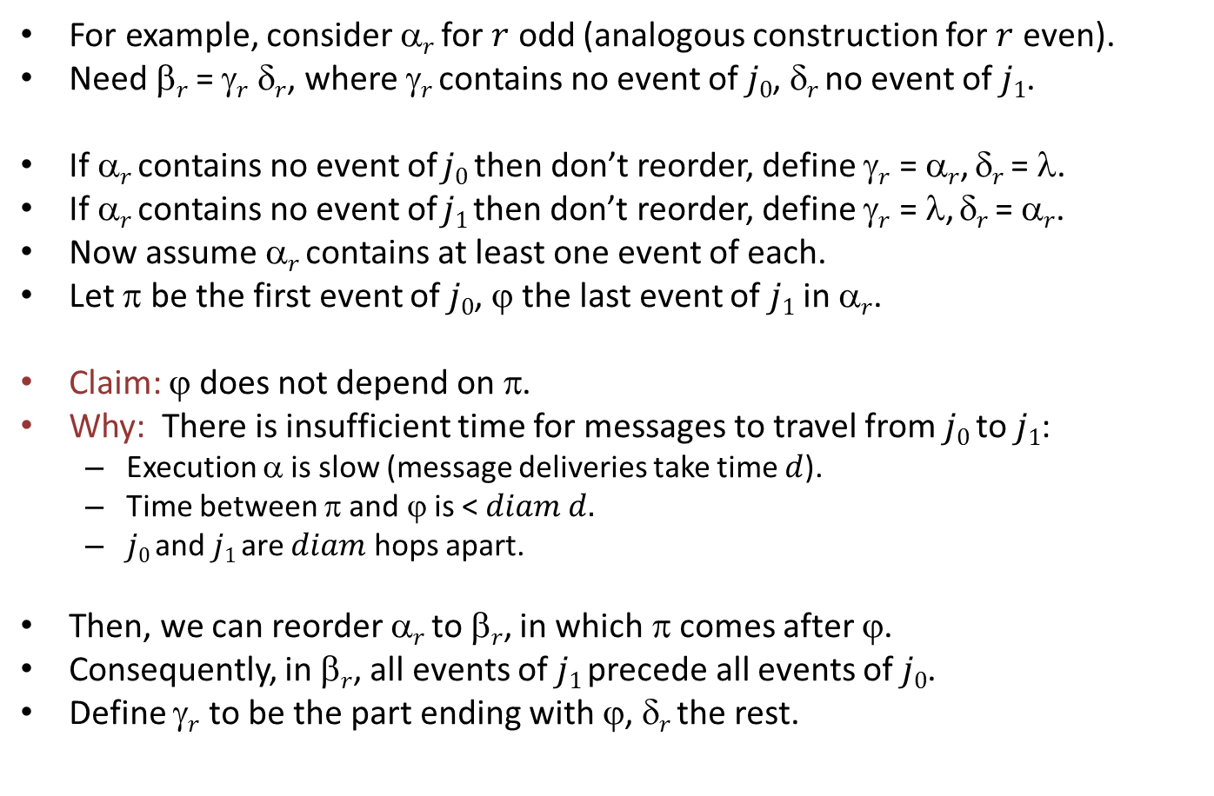
Constructing the reordering
For example, consider α$r$ for $r$ odd (analogous construction for $r$ even).
Need β$r$ = γ$r$ δ$r$, where γ$r$ contains no event of $j0$, δ$r$ no event of $j1$.
If α$r$ contains no event of $j0$ then don’t reorder, define γ$r$ = α$r$, δ$r$ = λ.
If α$r$ contains no event of $j1$then don’t reorder, define γ$r$ = λ, δ$r$ = α$r$.
Now assume α$r$ contains at least one event of each.
Let π be the first event of $j0$, ϕ the last event of $j1$ in α$r$.
Claim: ϕ does not depend on π.
Why: There is insufficient time for messages to travel from $j0$ to $j1$:
Execution α is slow (message deliveries take time $d$).
Time between π and ϕ is < $diam d.$
$j0$ and $j1$ are $diam$ hops apart.
Then, we can reorder α$r$ to β$r$, in which π comes after ϕ.
Consequently, in β$r$, all events of $j1$ precede all events of $j0$.
Define γ$r$ to be the part ending with ϕ, δ$r$ the rest.
Notes:
Note: The contradiction doesn’t mention timing. It’s just that we get too few sessions.

Slide 44
Next time…
Time, clocks, and the ordering of events in a distributed system.
State-machine emulation.
Vector timestamps.
Reading:
Chapter 18
[Lamport] Time, Clocks…paper
[Mattern] paper

